Slide 1

Operation Analytics and Investigating Metric Spike
Shreya Gunjal

Slide 2
Project Overview
This project focuses on evaluating effectiveness of day to day operations of the Microsoft company. Using SQL we will create a database and evaluate efficiency markers like jobs reviewed per hour per day, identification of wrong data or duplicate data, analyze languages used on the platform, etc.
It also involves studying metric spikes, analyzing data to gather insights by observing trends in user engagement, retention rate, engagement per device, engagement through email, etc.
These investigations will help us come to conclusions and ideas for building strategies to target inactive users, plan collaboration with other companies, launch ad-campaigns, etc.

Slide 3
Approach
Based on the given data the easiest and least time consuming process was used, by using SQL workbench as the information was more readable using tables. It also made it easier to compare different tables, join them or use aggregation functions.
Tables were created in SQL from given dataset.
View tables have also been created in some cases to use for ease for certain queries, to be used for other queries later.
The findings to each of the queries using graphs, bar columns, tables, etc. are answered in the following slides along with code used to arrive to the conclusion.
The following slides mention the questions to be targeted in this presentation.

Slide 4
Job Data Analysis
04
Throughput Analysis
03
Duplicate Rows Detection
Jobs Reviewed Over Time
02
Language Share Analysis
01

Slide 5
Investing Metric Spike
05
Weekly User Engagement
06
Weekly Retention Analysis
Weekly Engagement Per Device
User Growth Analysis
07
Email Engagement Analysis
08
09

Slide 6


Tech-Stack Used:
MySQL Workbench 8.0
Microsoft Excel
The tech stack was used due to it being crucial for table calculations and dealing with big datasets with ease as it is easy to use and less time-consuming.
Excel was used to create tables and charts to represent results obtained from sql

Slide 7
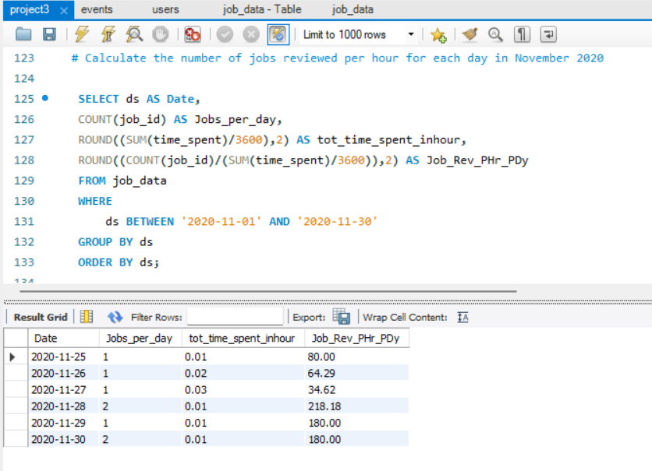
01
Jobs Reviewed Over Time:
Objective: Calculate the number of jobs reviewed per hour for each day in November 2020.
Your Task: Write an SQL query to calculate the number of jobs

Slide 8
Date | Jobs_per_day | Tot_time_spent_inhour | Job_Rev_PHr_PDy
25-11-2020 | 1 | 0.01 | 80
26-11-2020 | 1 | 0.02 | 64.29
27-11-2020 | 1 | 0.03 | 34.62
28-11-2020 | 2 | 0.01 | 218.18
29-11-2020 | 1 | 0.01 | 180
30-11-2020 | 2 | 0.01 | 180

Slide 9
Insights
As the data is not big enough to calculate the jobs reviewed per hour per day for every day of the month, the data is given for the last five days.
According to this data, the highest hourly review rate occurred on the last three days specifically on Saturday, 28th Nov 2020 and the lowest on 27th Nov 2020.
From the table, we can observe that the total time spent for job reviews on most days of November 2020 was between 0.01 and 0.03 hours.

Slide 10
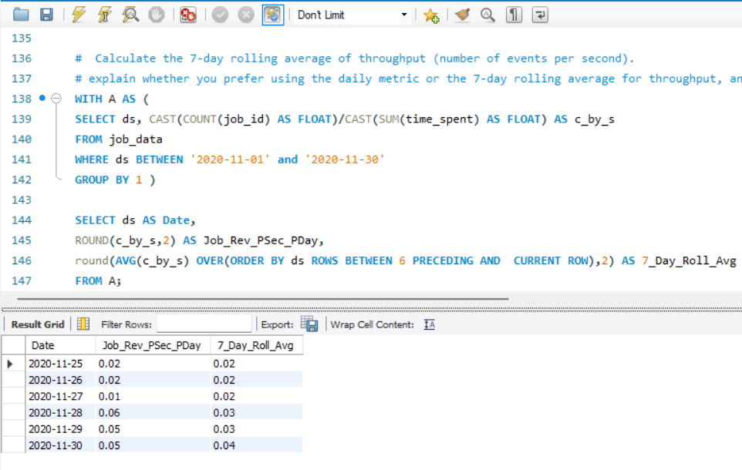
02
Throughput Analysis:
Objective: Calculate the 7-day rolling average of throughput (number of events per second).
Your Task: Write an SQL query to calculate the 7-day rolling average of throughput. Additionally, explain whether you prefer using the daily metric or the 7-day rolling average for throughput, and why.

Slide 12
Insights
From the daily line plot, we cannot observe any particular trend, but job reviews per second for each day is between 0.01 and 0.06
From the 7-day rolling average plot, one can make out that the 7 day rolling average either stays steady and increases during last 2 days.
7-Day Rolling Average should be preferred for being more reliable over daily metric for throughput. Daily metrics can go up or down on a daily basis either randomly or due to reasons that cannot be predicted. Conclusions made on this basis can prove to be harmful as they do not indicate a steady trend but a spike in the statistics.

Slide 13
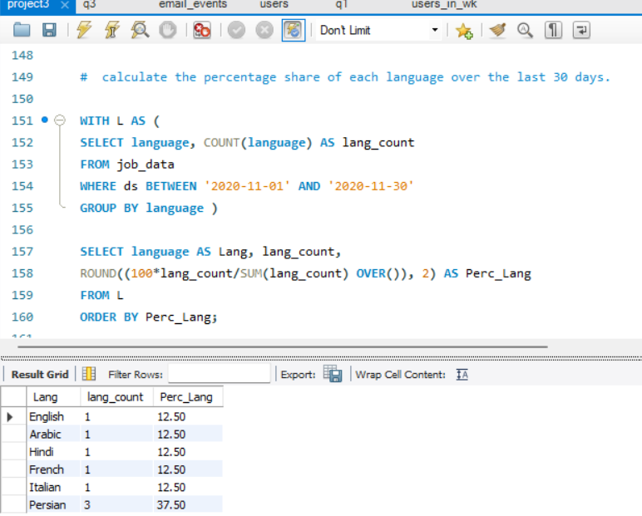
03
Language Share Analysis:
Objective: Calculate the percentage share of each language in the last 30 days.
Your Task: Write an SQL query to calculate the percentage share of each language over the last 30 days.

Slide 14
Lang | lang_count | Perc_Lang
English | 1 | 12.5
Arabic | 1 | 12.5
Hindi | 1 | 12.5
French | 1 | 12.5
Italian | 1 | 12.5
Persian | 3 | 37.5

Slide 15
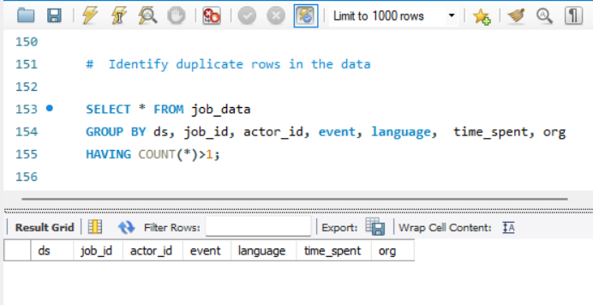
04
Duplicate Rows Detection:
Objective: Identify duplicate rows in the data.
Your Task: Write an SQL query to display duplicate rows from the job_data table.

Slide 16
Insights
From the data it can be observed that the language most used is Persian.
The other five languages are only used once. Again the data is not large enough to see a trend but Persian language is preferred.
There are no duplicate rows of data present in the table. Only certain values like language, dates are repeated which doesn’t affect the validity of the data.

Slide 17
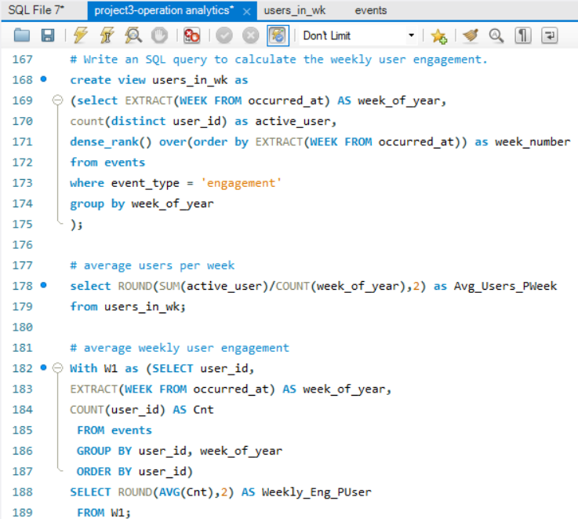
Weekly User Engagement:
Objective: Measure the activeness of users on a weekly basis.
Your Task: Write an SQL query to calculate the weekly user engagement.

Slide 19
14.77
1158.68
Users Engaging Per Week
Engagements Per User Per Week

Slide 20
Insights
The data starts with 17th week of the year 2014 as in, 1st May 2014. The SQL query gives week numbers starting from Sunday.
Therefore, the number of active users is less for week 17 (having only three days) and week 35 (a Sunday).
The number of active users is the highest for the month of July. The amount of active users seem to be consistently increasing and peaking at the 30th week (27th July- 2nd Aug). Although it decreases after that, no remarkable trend is seen.
A user typically has 14.77 engagements per user per week according to the data. Out of 9381 total users signed up, only an average of 1158.68 users engage with the platform on a weekly basis.

Slide 21
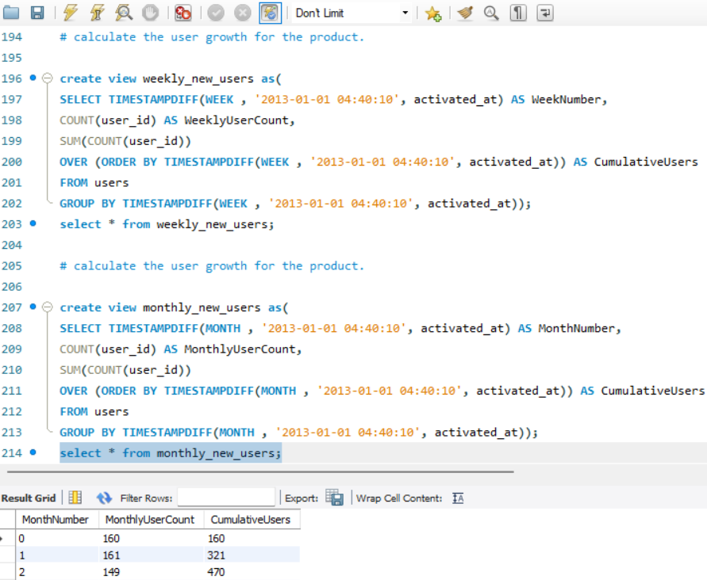
User Growth Analysis:
Objective: Analyze the growth of users over time for a product.
Your Task: Write an SQL query to calculate the user growth for the product.

Slide 24
WeekNumber | WeeklyUserCount | CumulativeUsers
0 | 30 | 30
1 | 34 | 64
2 | 46 | 110
3 | 35 | 145
4 | 35 | 180
5 | 40 | 220
6 | 44 | 264
7 | 39 | 303
8 | 35 | 338
9 | 42 | 380
10 | 31 | 411
11 | 34 | 445
12 | 32 | 477
13 | 42 | 519
14 | 32 | 551
15 | 44 | 595
16 | 50 | 645
17 | 43 | 688
18 | 53 | 741
19 | 50 | 791
20 | 40 | 831
21 | 55 | 886
22 | 50 | 936
23 | 50 | 986
24 | 50 | 1036
25 | 50 | 1086
26 | 54 | 1140
27 | 59 | 1199
28 | 75 | 1274
29 | 66 | 1340
30 | 63 | 1403
31 | 73 | 1476
32 | 66 | 1542
33 | 76 | 1618
34 | 76 | 1694
35 | 68 | 1762
36 | 72 | 1834
37 | 86 | 1920
38 | 89 | 2009
39 | 81 | 2090
40 | 84 | 2174
41 | 79 | 2253
42 | 96 | 2349
43 | 94 | 2443
44 | 94 | 2537
45 | 95 | 2632
46 | 85 | 2717
47 | 103 | 2820
48 | 103 | 2923
49 | 113 | 3036
50 | 124 | 3160
51 | 101 | 3261
52 | 135 | 3396
53 | 119 | 3515
54 | 121 | 3636
55 | 103 | 3739
56 | 141 | 3880
57 | 128 | 4008
58 | 133 | 4141
59 | 131 | 4272
60 | 125 | 4397
61 | 143 | 4540
62 | 143 | 4683
63 | 136 | 4819
64 | 158 | 4977
65 | 159 | 5136
66 | 170 | 5306
67 | 165 | 5471
68 | 181 | 5652
69 | 155 | 5807
70 | 170 | 5977
71 | 186 | 6163
72 | 167 | 6330
73 | 195 | 6525
74 | 200 | 6725
75 | 205 | 6930
76 | 222 | 7152
77 | 204 | 7356
78 | 215 | 7571
79 | 207 | 7778
80 | 218 | 7996
81 | 232 | 8228
82 | 217 | 8445
83 | 208 | 8653
84 | 254 | 8907
85 | 261 | 9168
86 | 213 | 9381

Slide 25
Insights
The data starts with week 0 of the year 2013 as in, 1st Jan 2013 and ends with 84th week , 31st Aug 2014. The SQL query gives week numbers starting from Sunday.
According to the two graphs, there is a consistent growth of new users per month, going from 160 new users on the first month, Jan 2013 to 1028 new users on the last month, Aug 2014. There is a small dip in new users on Jan 2014(month 13).
The number of users have increased tremendously and a trend of continuous user growth is observed which is good for the company

Slide 26
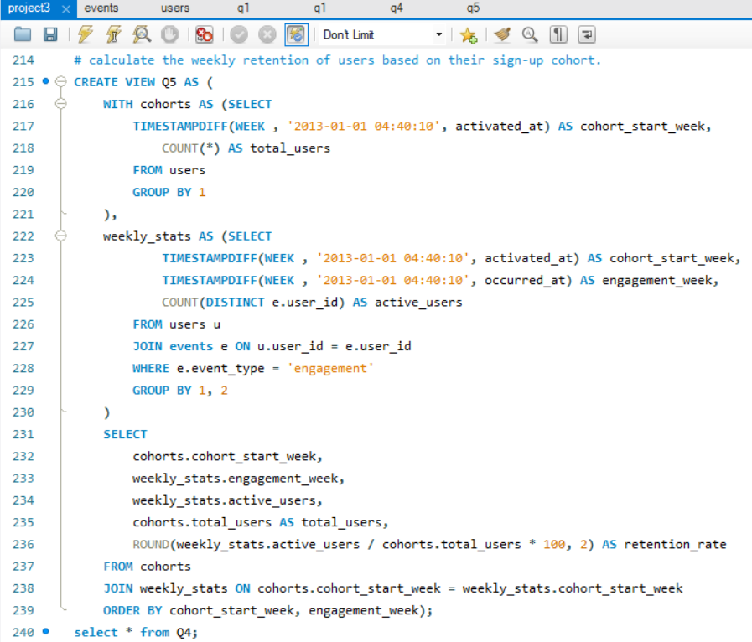
Weekly Retention Analysis :
Objective: Analyze the retention of users on a weekly basis after signing up for a product.
Your Task: Write an SQL query to calculate the weekly retention of users based on their sign-up cohort.

Slide 27
Engagement based Week number starting from 2013
Week no. | 69 | 70 | 71 | 72 | 73 | 74 | 75 | 76 | 77 | 78 | 79 | 80 | 81 | 82 | 83 | 84 | 85 | 86
0 | 10 | 13.33 | 10 | 10 | 13.33 | 13.33 | 13.33 | 26.67 | 13.33 | 10 | 10 | 6.67 | 3.33 | 13.33 | 10 | 13.33 | 10 | 6.67
1 |  | 5.88 | 11.76 | 8.82 | 11.76 | 14.71 | 8.82 | 14.71 | 17.65 | 5.88 |  | 8.82 | 11.76 | 14.71 | 11.76 | 5.88 | 14.71 | 8.82
2 | 6.52 | 13.04 | 13.04 | 15.22 | 15.22 | 19.57 | 15.22 | 15.22 | 4.35 | 2.17 | 8.7 | 10.87 | 4.35 | 4.35 | 2.17 |  | 8.7 | 8.7
3 | 11.43 | 17.14 | 17.14 | 20 | 22.86 | 14.29 | 11.43 | 14.29 | 17.14 | 14.29 | 14.29 | 17.14 | 20 | 11.43 | 5.71 | 2.86 | 2.86 | 8.57
4 | 5.71 | 22.86 | 14.29 | 17.14 | 17.14 | 11.43 | 14.29 | 20 | 20 | 17.14 | 20 | 20 | 25.71 | 22.86 | 22.86 | 20 | 8.57
5 | 12.5 | 10 | 17.5 | 10 | 10 | 17.5 | 15 | 15 | 17.5 | 15 | 15 | 12.5 | 17.5 | 12.5 | 7.5 | 7.5 | 12.5 | 10
6 | 6.82 | 18.18 | 13.64 | 13.64 | 15.91 | 18.18 | 11.36 | 11.36 | 13.64 | 15.91 | 13.64 | 20.45 | 13.64 | 15.91 | 6.82 | 2.27 |  | 6.82
7 | 7.69 | 17.95 | 10.26 | 15.38 | 10.26 | 10.26 | 15.38 | 20.51 | 20.51 | 15.38 | 17.95 | 20.51 | 17.95 | 12.82 | 12.82 | 10.26 | 5.13 | 7.69
8 | 8.57 | 5.71 | 14.29 | 20 | 11.43 | 11.43 | 11.43 | 14.29 | 11.43 | 14.29 | 2.86 | 17.14 | 14.29 | 14.29 | 8.57 | 5.71 | 5.71 | 5.71
9 | 11.9 | 19.05 | 16.67 | 23.81 | 11.9 | 16.67 | 23.81 | 19.05 | 19.05 | 26.19 | 14.29 | 19.05 | 19.05 | 16.67 | 9.52 | 7.14 | 4.76 | 7.14
10 | 16.13 | 6.45 | 9.68 | 9.68 | 12.9 | 22.58 | 12.9 | 6.45 | 9.68 | 16.13 | 12.9 | 16.13 | 6.45 | 12.9 | 6.45 | 6.45 | 6.45
11 | 11.76 | 17.65 | 17.65 | 14.71 | 20.59 | 11.76 | 14.71 | 8.82 | 11.76 | 17.65 | 11.76 | 8.82 | 14.71 | 23.53 | 20.59 | 17.65 | 14.71 | 14.71
12 | 12.5 | 6.25 | 6.25 | 6.25 | 12.5 | 18.75 | 9.38 | 9.38 | 15.63 | 15.63 | 6.25 | 21.88 | 12.5 | 15.63 | 9.38 | 6.25 | 6.25 | 6.25
13 | 7.14 | 9.52 | 9.52 | 11.9 | 9.52 | 7.14 | 7.14 | 7.14 | 7.14 | 7.14 | 19.05 | 14.29 | 14.29 | 23.81 | 21.43 | 9.52 | 9.52 | 4.76
14 | 6.25 | 9.38 | 12.5 | 12.5 | 6.25 | 15.63 | 18.75 | 21.88 | 12.5 | 6.25 | 9.38 | 12.5 | 15.63 | 15.63 | 9.38 | 15.63 | 9.38 | 6.25
15 | 13.64 | 15.91 | 13.64 | 15.91 | 13.64 | 15.91 | 11.36 | 18.18 | 11.36 | 13.64 | 15.91 | 13.64 | 22.73 | 22.73 | 9.09 | 20.45 | 13.64 | 6.82
16 | 14 | 18 | 22 | 20 | 32 | 20 | 16 | 22 | 20 | 26 | 22 | 24 | 22 | 16 | 14 | 18 | 12 | 14
17 | 6.98 | 11.63 | 18.6 | 18.6 | 9.3 | 6.98 | 16.28 | 13.95 | 9.3 | 16.28 | 11.63 | 13.95 | 20.93 | 18.6 | 9.3 | 11.63 | 18.6 | 13.95
18 | 13.21 | 15.09 | 16.98 | 20.75 | 16.98 | 18.87 | 22.64 | 15.09 | 15.09 | 13.21 | 24.53 | 15.09 | 16.98 | 13.21 | 15.09 | 13.21 | 7.55 | 3.77
19 | 8 | 16 | 22 | 16 | 12 | 2 | 14 | 12 | 8 | 14 | 16 | 16 | 10 | 10 | 12 | 12 | 6 | 8
20 | 7.5 | 5 | 5 | 2.5 | 5 | 7.5 | 2.5 | 7.5 | 7.5 | 12.5 | 7.5 | 10 | 7.5 | 2.5 | 2.5 | 5 | 2.5 | 2.5
21 | 5.45 | 10.91 | 7.27 | 9.09 | 7.27 | 5.45 | 7.27 | 3.64 | 5.45 | 3.64 | 9.09 | 5.45 | 1.82 | 5.45 | 5.45 | 3.64 | 3.64 | 7.27
22 | 12 | 10 | 14 | 10 | 4 | 6 | 10 | 10 | 6 | 16 | 14 | 20 | 18 | 22 | 12 | 8 | 10 | 10
23 | 14 | 8 | 6 | 10 | 12 | 12 | 10 | 10 | 10 | 10 | 12 | 8 | 10 | 4 | 4 | 8 | 6 | 4
24 | 8 | 4 | 8 | 6 | 8 | 4 | 6 | 8 | 12 | 14 | 16 | 16 | 12 | 6 | 6 | 2 | 10 | 8
25 | 10 | 14 | 18 | 10 | 10 | 6 | 8 | 6 | 12 | 10 | 16 | 10 | 10 | 12 | 14 | 6 | 8 | 12
26 | 5.56 | 7.41 | 18.52 | 14.81 | 14.81 | 9.26 | 9.26 | 14.81 | 9.26 | 7.41 | 11.11 | 11.11 | 9.26 | 7.41 | 7.41 | 5.56 | 7.41 | 7.41
27 | 6.78 | 13.56 | 13.56 | 10.17 | 8.47 | 5.08 | 8.47 | 6.78 | 8.47 | 6.78 | 10.17 | 10.17 | 13.56 | 16.95 | 8.47 | 8.47 | 3.39 | 5.08
28 | 12 | 14.67 | 14.67 | 10.67 | 13.33 | 14.67 | 10.67 | 10.67 | 14.67 | 12 | 13.33 | 12 | 9.33 | 5.33 | 9.33 | 8 | 6.67 | 6.67
Signup Cohort Week of Year 2013

Slide 28
Engagement based Week number starting from 2013
Week no. | 69 | 70 | 71 | 72 | 73 | 74 | 75 | 76 | 77 | 78 | 79 | 80 | 81 | 82 | 83 | 84 | 85 | 86
29 | 15.15 | 15.15 | 18.18 | 15.15 | 13.64 | 21.21 | 21.21 | 18.18 | 13.64 | 15.15 | 15.15 | 9.09 | 13.64 | 10.61 | 6.06 | 7.58 | 4.55 | 7.58
30 | 15.87 | 15.87 | 12.7 | 11.11 | 7.94 | 14.29 | 12.7 | 12.7 | 14.29 | 15.87 | 12.7 | 11.11 | 12.7 | 12.7 | 9.52 | 12.7 | 7.94 | 4.76
31 | 12.33 | 12.33 | 13.7 | 15.07 | 8.22 | 8.22 | 16.44 | 17.81 | 12.33 | 8.22 | 2.74 | 5.48 | 5.48 | 5.48 | 8.22 | 8.22 | 12.33 | 8.22
32 | 15.15 | 22.73 | 15.15 | 13.64 | 10.61 | 4.55 | 10.61 | 13.64 | 13.64 | 13.64 | 12.12 | 10.61 | 10.61 | 7.58 | 6.06 | 7.58 | 4.55 | 7.58
33 | 7.89 | 13.16 | 14.47 | 14.47 | 13.16 | 13.16 | 10.53 | 15.79 | 14.47 | 22.37 | 17.11 | 13.16 | 18.42 | 21.05 | 15.79 | 11.84 | 10.53 | 10.53
34 | 9.21 | 9.21 | 10.53 | 6.58 | 9.21 | 7.89 | 11.84 | 14.47 | 11.84 | 10.53 | 19.74 | 10.53 | 13.16 | 11.84 | 9.21 | 6.58 | 3.95 | 2.63
35 | 8.82 | 13.24 | 14.71 | 16.18 | 14.71 | 11.76 | 13.24 | 10.29 | 11.76 | 17.65 | 14.71 | 13.24 | 10.29 | 13.24 | 13.24 | 11.76 | 14.71 | 10.29
36 | 6.94 | 11.11 | 13.89 | 12.5 | 11.11 | 13.89 | 12.5 | 13.89 | 12.5 | 9.72 | 12.5 | 13.89 | 13.89 | 13.89 | 12.5 | 11.11 | 6.94 | 5.56
37 | 8.14 | 8.14 | 8.14 | 8.14 | 9.3 | 12.79 | 16.28 | 15.12 | 12.79 | 6.98 | 8.14 | 5.81 | 6.98 | 4.65 | 3.49 | 2.33 | 6.98 | 3.49
38 | 11.24 | 14.61 | 11.24 | 11.24 | 11.24 | 10.11 | 16.85 | 8.99 | 12.36 | 7.87 | 13.48 | 13.48 | 8.99 | 11.24 | 10.11 | 7.87 | 4.49 | 5.62
39 | 6.17 | 8.64 | 11.11 | 14.81 | 9.88 | 13.58 | 11.11 | 8.64 | 7.41 | 11.11 | 9.88 | 11.11 | 11.11 | 8.64 | 4.94 | 6.17 | 6.17 | 6.17
40 | 8.33 | 13.1 | 9.52 | 5.95 | 9.52 | 7.14 | 13.1 | 15.48 | 16.67 | 11.9 | 5.95 | 11.9 | 13.1 | 19.05 | 13.1 | 11.9 | 8.33 | 7.14
41 | 8.86 | 11.39 | 15.19 | 11.39 | 10.13 | 8.86 | 8.86 | 8.86 | 5.06 | 7.59 | 8.86 | 11.39 | 8.86 | 7.59 | 6.33 | 2.53 | 2.53 | 3.8
42 | 8.33 | 10.42 | 9.38 | 12.5 | 10.42 | 11.46 | 14.58 | 13.54 | 11.46 | 8.33 | 6.25 | 5.21 | 11.46 | 11.46 | 13.54 | 11.46 | 11.46 | 7.29
43 | 10.64 | 12.77 | 14.89 | 13.83 | 15.96 | 15.96 | 18.09 | 10.64 | 10.64 | 9.57 | 9.57 | 8.51 | 8.51 | 10.64 | 6.38 | 2.13 | 5.32 | 6.38
44 | 11.7 | 11.7 | 9.57 | 6.38 | 7.45 | 10.64 | 14.89 | 13.83 | 9.57 | 13.83 | 13.83 | 11.7 | 9.57 | 11.7 | 10.64 | 11.7 | 7.45 | 3.19
45 | 7.37 | 13.68 | 21.05 | 14.74 | 9.47 | 15.79 | 14.74 | 16.84 | 11.58 | 17.89 | 15.79 | 12.63 | 9.47 | 11.58 | 8.42 | 7.37 | 15.79 | 11.58
46 | 5.88 | 8.24 | 7.06 | 3.53 | 8.24 | 5.88 | 10.59 | 8.24 | 10.59 | 8.24 | 11.76 | 10.59 | 7.06 | 10.59 | 10.59 | 5.88 | 11.76 | 5.88
47 | 5.83 | 6.8 | 6.8 | 10.68 | 11.65 | 11.65 | 14.56 | 9.71 | 10.68 | 15.53 | 11.65 | 9.71 | 13.59 | 10.68 | 6.8 | 5.83 | 5.83 | 3.88
48 | 3.88 | 7.77 | 8.74 | 9.71 | 10.68 | 9.71 | 14.56 | 14.56 | 9.71 | 11.65 | 9.71 | 11.65 | 15.53 | 11.65 | 7.77 | 5.83 | 5.83 | 1.94
49 | 7.08 | 7.96 | 9.73 | 13.27 | 9.73 | 11.5 | 10.62 | 10.62 | 11.5 | 7.96 | 9.73 | 8.85 | 11.5 | 11.5 | 6.19 | 7.96 | 2.65 | 6.19
50 | 5.65 | 13.71 | 14.52 | 14.52 | 13.71 | 15.32 | 12.9 | 16.13 | 11.29 | 8.87 | 7.26 | 8.87 | 5.65 | 5.65 | 9.68 | 5.65 | 0.81 | 1.61
51 | 4.95 | 13.86 | 7.92 | 9.9 | 7.92 | 7.92 | 7.92 | 7.92 | 9.9 | 11.88 | 5.94 | 6.93 | 5.94 | 6.93 | 3.96 | 6.93 | 4.95 | 5.94
52 | 5.93 | 11.11 | 17.04 | 14.07 | 12.59 | 11.85 | 9.63 | 14.07 | 11.85 | 13.33 | 9.63 | 10.37 | 9.63 | 8.89 | 8.89 | 10.37 | 5.19 | 4.44
53 | 5.04 | 9.24 | 7.56 | 10.08 | 10.92 | 6.72 | 8.4 | 10.08 | 7.56 | 9.24 | 11.76 | 8.4 | 6.72 | 5.88 | 9.24 | 5.88 | 4.2 | 1.68
54 | 6.61 | 13.22 | 15.7 | 13.22 | 12.4 | 17.36 | 16.53 | 12.4 | 12.4 | 15.7 | 12.4 | 9.09 | 12.4 | 9.92 | 12.4 | 9.92 | 11.57 | 9.92
55 | 7.77 | 7.77 | 17.48 | 17.48 | 18.45 | 13.59 | 11.65 | 8.74 | 6.8 | 10.68 | 12.62 | 9.71 | 8.74 | 10.68 | 8.74 | 7.77 | 10.68 | 7.77
56 | 11.35 | 14.89 | 11.35 | 9.93 | 7.8 | 14.18 | 12.77 | 13.48 | 12.77 | 14.89 | 12.06 | 9.22 | 9.22 | 14.18 | 11.35 | 10.64 | 9.22 | 6.38
Signup Cohort Week of Year 2013

Slide 29
Engagement based Week number starting from 2013
Week no. | 69 | 70 | 71 | 72 | 73 | 74 | 75 | 76 | 77 | 78 | 79 | 80 | 81 | 82 | 83 | 84 | 85 | 86
57 | 14.06 | 16.41 | 16.41 | 10.94 | 9.38 | 10.16 | 12.5 | 13.28 | 13.28 | 12.5 | 10.16 | 9.38 | 10.16 | 11.72 | 10.94 | 7.81 | 12.5 | 8.59
58 | 11.28 | 9.02 | 9.02 | 9.77 | 12.78 | 14.29 | 14.29 | 12.03 | 9.02 | 9.77 | 11.28 | 9.77 | 8.27 | 8.27 | 9.02 | 9.02 | 7.52 | 5.26
59 | 8.4 | 12.21 | 7.63 | 11.45 | 9.92 | 11.45 | 10.69 | 9.92 | 13.74 | 9.92 | 14.5 | 12.98 | 15.27 | 11.45 | 13.74 | 8.4 | 6.87 | 9.16
60 | 9.6 | 12 | 10.4 | 9.6 | 9.6 | 12.8 | 12 | 9.6 | 12.8 | 9.6 | 7.2 | 9.6 | 12.8 | 9.6 | 10.4 | 8.8 | 11.2 | 10.4
61 | 11.89 | 16.08 | 11.89 | 9.79 | 11.89 | 9.79 | 10.49 | 8.39 | 6.99 | 13.29 | 16.78 | 13.29 | 13.29 | 9.09 | 7.69 | 5.59 | 6.99 | 5.59
62 | 8.39 | 11.89 | 14.69 | 10.49 | 9.79 | 8.39 | 8.39 | 9.79 | 8.39 | 6.29 | 7.69 | 7.69 | 9.09 | 9.79 | 9.09 | 7.69 | 4.9 | 4.9
63 | 12.5 | 16.18 | 17.65 | 17.65 | 17.65 | 14.71 | 13.97 | 13.97 | 15.44 | 13.97 | 13.24 | 14.71 | 14.71 | 16.18 | 15.44 | 12.5 | 10.29 | 5.88
64 | 18.35 | 17.72 | 14.56 | 17.72 | 14.56 | 15.82 | 10.76 | 11.39 | 11.39 | 10.76 | 10.76 | 12.66 | 13.29 | 12.66 | 12.66 | 9.49 | 10.13 | 8.86
65 | 24.53 | 16.35 | 15.72 | 12.58 | 11.32 | 11.95 | 14.47 | 12.58 | 11.32 | 10.06 | 12.58 | 14.47 | 11.95 | 12.58 | 11.32 | 7.55 | 8.18 | 7.55
66 | 17.06 | 20.59 | 17.06 | 18.82 | 15.88 | 14.71 | 11.18 | 11.18 | 10 | 11.18 | 11.76 | 11.76 | 12.94 | 14.71 | 10.59 | 8.82 | 10 | 7.65
67 | 39.39 | 36.97 | 30.3 | 21.21 | 15.76 | 15.15 | 12.12 | 10.3 | 12.73 | 10.91 | 9.7 | 10.91 | 12.73 | 10.91 | 9.7 | 7.88 | 6.06 | 4.24
68 | 44.2 | 38.67 | 28.18 | 19.34 | 14.36 | 9.39 | 7.18 | 8.29 | 10.5 | 11.6 | 9.94 | 8.29 | 7.73 | 8.29 | 9.39 | 6.08 | 6.08 | 3.87
69 | 94.84 | 65.81 | 35.48 | 27.74 | 17.42 | 18.06 | 14.84 | 12.26 | 10.32 | 8.39 | 9.68 | 10.32 | 9.68 | 9.68 | 7.74 | 9.68 | 5.81 | 5.16
70 |  | 100 | 65.88 | 43.53 | 30.59 | 22.94 | 12.35 | 10 | 13.53 | 10 | 12.94 | 10 | 7.65 | 7.65 | 5.88 | 6.47 | 5.29 | 1.76
71 |  |  | 100 | 68.82 | 41.4 | 33.87 | 22.04 | 13.44 | 10.22 | 10.22 | 10.75 | 9.68 | 8.6 | 8.06 | 6.99 | 7.53 | 6.45 | 3.23
72 |  |  |  | 100 | 67.07 | 44.91 | 28.74 | 23.95 | 14.97 | 11.98 | 17.37 | 13.77 | 13.77 | 13.17 | 11.98 | 7.78 | 3.59 | 5.39
73 |  |  |  |  | 100 | 60 | 42.56 | 30.26 | 16.92 | 15.38 | 17.44 | 16.41 | 11.28 | 10.26 | 7.69 | 10.26 | 6.67 | 4.62
74 |  |  |  |  |  | 100 | 66.5 | 44 | 34.5 | 22 | 19 | 13.5 | 12.5 | 9.5 | 8 | 7 | 3.5 | 2
75 |  |  |  |  |  |  | 100 | 70.24 | 41.95 | 29.76 | 24.88 | 22.44 | 18.05 | 15.61 | 10.73 | 11.22 | 7.32 | 3.9
76 |  |  |  |  |  |  |  | 100 | 61.26 | 42.79 | 27.03 | 18.47 | 15.77 | 13.51 | 9.46 | 5.86 | 6.31 | 4.95
77 |  |  |  |  |  |  |  |  | 100 | 65.69 | 43.14 | 28.92 | 21.08 | 15.2 | 14.22 | 10.78 | 8.33 | 7.84
78 |  |  |  |  |  |  |  |  |  | 100 | 67.91 | 45.12 | 32.56 | 24.65 | 21.4 | 15.35 | 14.88 | 6.98
79 |  |  |  |  |  |  |  |  |  |  | 100 | 69.08 | 44.44 | 35.75 | 21.74 | 16.43 | 9.66 | 8.21
80 |  |  |  |  |  |  |  |  |  |  |  | 100 | 64.22 | 40.83 | 23.39 | 17.43 | 9.63 | 9.63
81 |  |  |  |  |  |  |  |  |  |  |  |  | 100 | 65.52 | 36.64 | 27.59 | 18.53 | 13.79
82 |  |  |  |  |  |  |  |  |  |  |  |  |  | 100 | 59.91 | 35.02 | 27.65 | 19.82
83 |  |  |  |  |  |  |  |  |  |  |  |  |  |  | 100 | 66.83 | 33.17 | 22.6
84 |  |  |  |  |  |  |  |  |  |  |  |  |  |  |  | 100 | 65.75 | 36.61
85 |  |  |  |  |  |  |  |  |  |  |  |  |  |  |  |  | 100 | 65.9
86 |  |  |  |  |  |  |  |  |  |  |  |  |  |  |  |  |  | 100
Signup Cohort Week of Year 2013

Slide 30
Insights
The data was derived using signup week cohorts starting from 1st Jan 2013(week 0) to 31st Aug 2014(week 86) and week numbers of engagement starting from 1st May 2014 (week 69) to 31st Aug 2014.
We can observe that user retention rate is low, below 10% for the starting week of engagement(week 69). This could be due to them interacting with the platform for the first time after signing up a while ago.
The retention rate further drastically falls down during last three weeks, 84,85 and 86. Week 86 consists of a single day- 31st Aug 2014 which explains the drastic falls. Also, the old users seem to be losing interest in using the platform with increase in time. This has to be addressed by email/ad-campaigns.
The user retention rate is highest for new users varying around 60-100%. This makes sense as the new users are likely to immediately engage with the platform even by simply signing up for it.
An interesting trend is observed of around 30-40% users not engaging with the platform the very next week of signing up between weeks 69 – 86.
Another noteworthy trend is that of the middle-week users having a consistent retention rate of 15-25 %.
The overall low retention rate of users needs to be addressed.

Slide 31
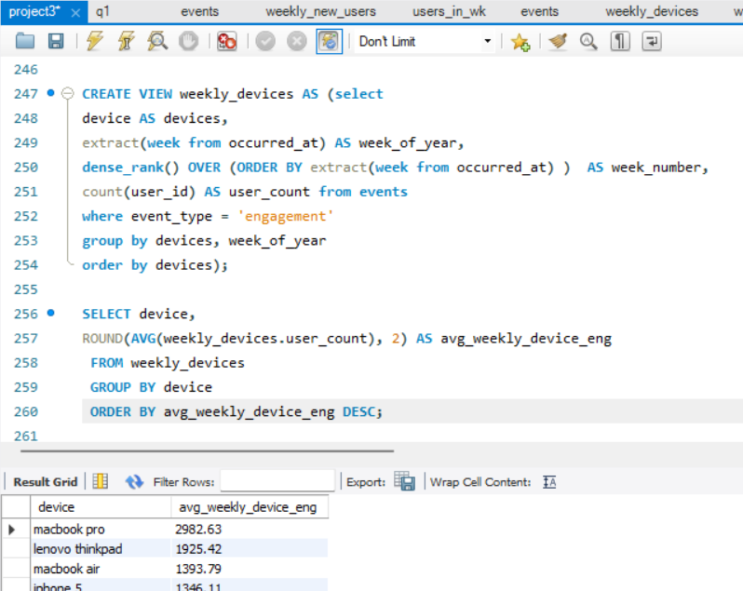
Weekly Engagement Per Device:
Objective: Measure the activeness of users on a weekly basis per device.
Your Task: Write an SQL query to calculate the weekly engagement per device.

Slide 32
Average weekly device engagement

Slide 33
Insights
The device that is most used is Macbook pro followed by Lenovo thinkpad, Macbook air, iphone 5 and dell inspiron notebook. Macbook Pros seem to be the most popular by a huge difference.
Most devices including top 3 for most used devices seem to be laptops. This makes sense as laptops are used in corporate environments.

Slide 34
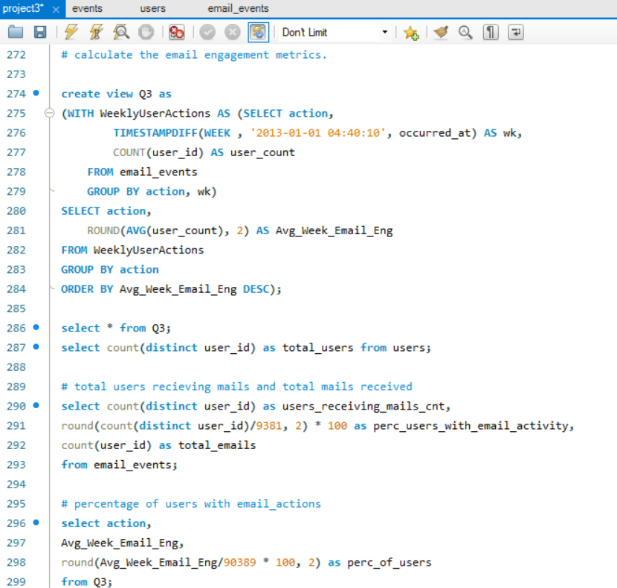
Email Engagement Analysis:
Objective: Analyze how users are engaging with the email service.
Your Task: Write an SQL query to calculate the email engagement metrics.

Slide 35
Average weekly user interactions with emails
57267
sent_weekly_digest
63.36 %
20459
email_open
22.63 %
9010
email_clickthrough
9.97 %
3653
sent_reengagement_email
4.04%

Slide 36
66% or 6179 users out of total interact with emails

Slide 37
Insights
It is seen that 6179 users have interacted with/been sent emails out of the total 9381 users. 63.36 % of those interactions including receiving the weekly digest via email.
22.63 % of email events include users opening the sent email.
It is important to reach out to more users via emails.

Slide 38
Conclusion and results
This project has helped me dive deeper into the world of operation analytics and metric studies. It was interesting to see how we can answer so many questions regarding customer behavior towards the product and get insights on underlying patterns observed.
The important insights gathered here were the need to address weekly user retention rate and why it’s low. It would be beneficial to address this issue via ad-campaigns targeting inactive users. Also, targeting emails to users that haven’t received an email before might be beneficial.
However, a great insight observed is the consistent increase in users

